Slide 1
ELECTRONIC VOTING MACHINE USING ARDUINO AND LCD
Submitted by
BHIMASHANKAR (SG20ECE027)

Slide 2
INTRODUCTION:
This project is all about Simple & Smart Electronic Voting Machine Using Arduino. The basic idea of this project is to create an electronic voting machine that will help to eradicate defrauding of the manual voting systems and prior versions of electronic voting.
In this project, i.e, Smart Electronic Voting Machine Using Arduino, we have used four pushbuttons for four different candidates who are taking part in the election. We can increase the number of the candidate as per requirement. When any voter press any of four buttons then respecting voting value will increment by one each time.
After the whole voting process, the fifth button is used as result button can be pressed to display the result. We have an LCD to display the voting for the satisfaction of the voters. Finally, the results can be calculated automatically simply by pressing the result button.

Slide 3
COMPONENTS REQUIRED:
Arduino UNO
16x2 Lcd display
10k ohm potentiometer
Push button switches
220 ohm resistors
5mm LED
Breadboard
Jumper wires

Slide 4
COMPONENTS REQUIRED:
Arduino UNO
16x2 Lcd display
10k ohm potentiometer
Push button switches
220 ohm resistors
5mm LED
Breadboard
Jumper wires

Slide 5
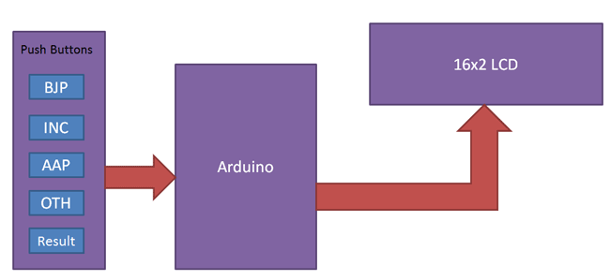
BLOCK DIAGRAM:

Slide 6
NEED FOR EVM USING ARDUINO
Efficiency: EVMs are designed to streamline the voting process by reducing the time it takes to cast and count votes. EVMs can be programmed to display candidate names and parties and to record votes electronically, making the process quicker and more efficient than using paper ballots.
Accuracy: EVMs are designed to eliminate errors that can occur with traditional paper ballots. EVMs can detect errors such as over-voting or under-voting, which can occur when voters mark more or fewer candidates than allowed.
Security: EVMs are designed to provide a higher level of security than traditional paper ballots. EVMs can be programmed to use encryption to secure the voting data and to prevent unauthorized access
Accessibility: EVMs are designed to be more accessible than traditional paper ballots. EVMs can be designed to accommodate voters with disabilities and to provide multiple language options.

Slide 7
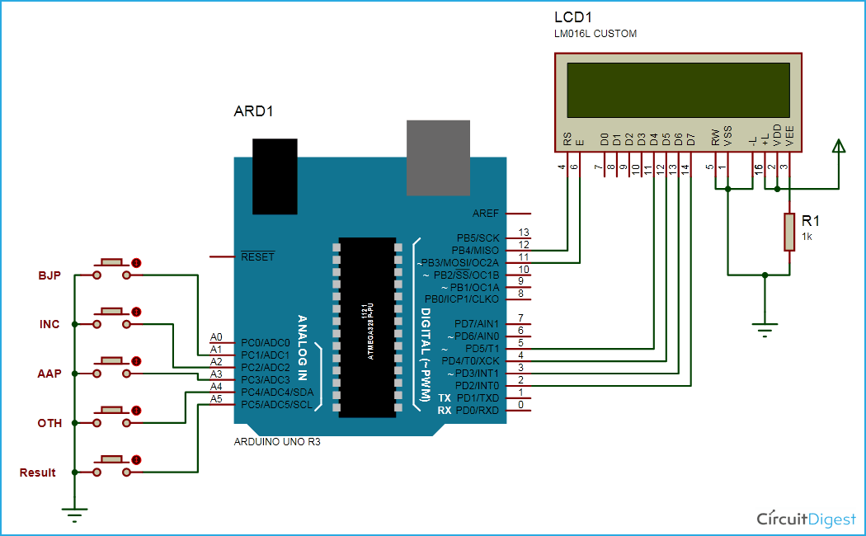
CIRCUIT DIAGRAM:

Slide 8
WORKING:
Part1:
Once on constructing the circuit diagram, we need upload the code into the Arduino using USB AB cable.
1. Go to: http://bit.ly/clc-arduino-2 , Upload the code and then Click the button to verify
the code.
2. Once verified, click the button to upload the code to the Arduino Uno.
3. Check the progress bar at the bottom to ensure the code was successfully uploaded.

Slide 9
Part 2:
Four push buttons (connected to pins 7-10) are used to register votes for the candidates. A green LED (connected to pin 6) is used to indicate when a vote has been cast. It will blink briefly after a button has been pressed.
A red LED (connected to pin 13) is used to indicate when the results are being displayed. It will blink briefly before the results are shown. The LCD screen (connected to pins 2-5 and 11-12) is used to display the total number of votes cast for each candidate.
The program waits for a button press, then increments the vote count for the corresponding candidate and blinks the green LED.The program then updates the LCD screen to show the updated vote counts for each candidate.
The program can be instructed to display the results by pressing a fifth button (connected to an arbitrary pin) which causes the red LED to blink and the total number of votes for each candidate to be displayed on the LCD screen.

Slide 10
ADVANTAGES AND DISADVANTAGES:
ADVANTAGES:
There are several advantages of using an electronic voting machine (EVM) with Arduino and an LCD display:
Accuracy: An EVM with an LCD display ensures accurate counting of votes. It eliminates the possibility of human error in counting and reduces the time required for the counting process.
Easy to use: The use of push buttons and an LCD screen makes it easy for voters to use the EVM. The LCD screen can display instructions for the voters, making it user-friendly.
Cost-effective: The use of Arduino and an LCD display is relatively cost-effective compared to other electronic voting machines. This makes it an affordable option for small-scale elections.
Flexibility: The use of Arduino makes it possible to customize the EVM to suit different voting systems. It can be programmed to handle different numbers of candidates, voting rules, and display formats.
Security: Arduino-based EVMs can be designed with security features such as password protection and encryption to prevent unauthorized access or tampering of the voting data. The use of push buttons instead of touch screens also eliminates the risk of hacking or manipulation.

Slide 11
DISADVANTAGES:
Here are some potential disadvantages of using an electronic voting machine (EVM) with Arduino and an LCD display:
Limited capacity: The use of Arduino and an LCD display may limit the capacity of the EVM in terms of the number of candidates or voters it can handle. This can be a challenge for larger elections where a larger number of candidates and voters need to be accommodated.
Vulnerability to malfunction: The use of electronic components in the EVM increases the risk of technical malfunctions that can disrupt the voting process. Malfunctions can also result in inaccurate vote counts, which can undermine the integrity of the election.
Dependence on electricity: EVMs require a stable source of electricity to operate, which can be a challenge in areas with unreliable or inadequate power supply. This can result in delays or interruptions in the voting process.
Accessibility: The use of an LCD display may pose challenges for voters with visual impairments. The display may also be difficult to read in bright sunlight or poorly lit areas.
Lack of transparency: The use of technology in the voting process can create a perception of lack of transparency, making it difficult for voters to verify that their votes have been accurately recorded and counted.

Slide 12
APPLICATIONS:
Here are some potential applications of an electronic voting machine (EVM) using Arduino and an LCD display:
Local and regional elections: EVMs can be used in local and regional elections, such as municipal or county-level elections. They can be designed to handle a moderate number of candidates and voters, and can be customized to suit local voting rules and regulations.
Student government elections: EVMs can be used in student government elections in schools and colleges. They can be a more efficient and accurate alternative to manual voting methods, and can help to promote transparency and fairness in the election process.
Small-scale elections: EVMs can be a cost-effective option for small-scale elections, such as those conducted by community groups, clubs, or non-profit organizations.
Polls and surveys: EVMs can also be used for conducting polls and surveys, such as market research or public opinion surveys.
Experimental research: EVMs can be used in experimental research to test different voting systems and to study voter behavior and decision-making.

Slide 13
CONCLUSION:
In conclusion, electronic voting machines (EVMs) using Arduino and LCD displays have the potential to improve the accuracy, efficiency, and transparency of the voting process. They can be used in a variety of applications, from local and regional elections to student government elections and small-scale polls and surveys.
However, there are also potential drawbacks to using EVMs, including limitations in capacity, vulnerability to malfunction, and dependence on electricity. To address these challenges, it is important to design and test EVMs thoroughly, and to provide adequate training and support to election officials and voters.
Looking to the future, there are exciting potential developments in the field of EVMs, such as integration with blockchain technology, artificial intelligence and machine learning, wireless and mobile voting, improved security, and open-source development. These developments have the potential to further improve the accuracy, security, and accessibility of EVMs, and to ensure that the voting process is transparent and fair for all.

Slide 14
THANK YOU♥

